Slide 1
INSIGHTS ON REAL TIME DATA OF YOU TUBE AND ITS CONTENT CREATORS
A PRESENTATION ON

Slide 2
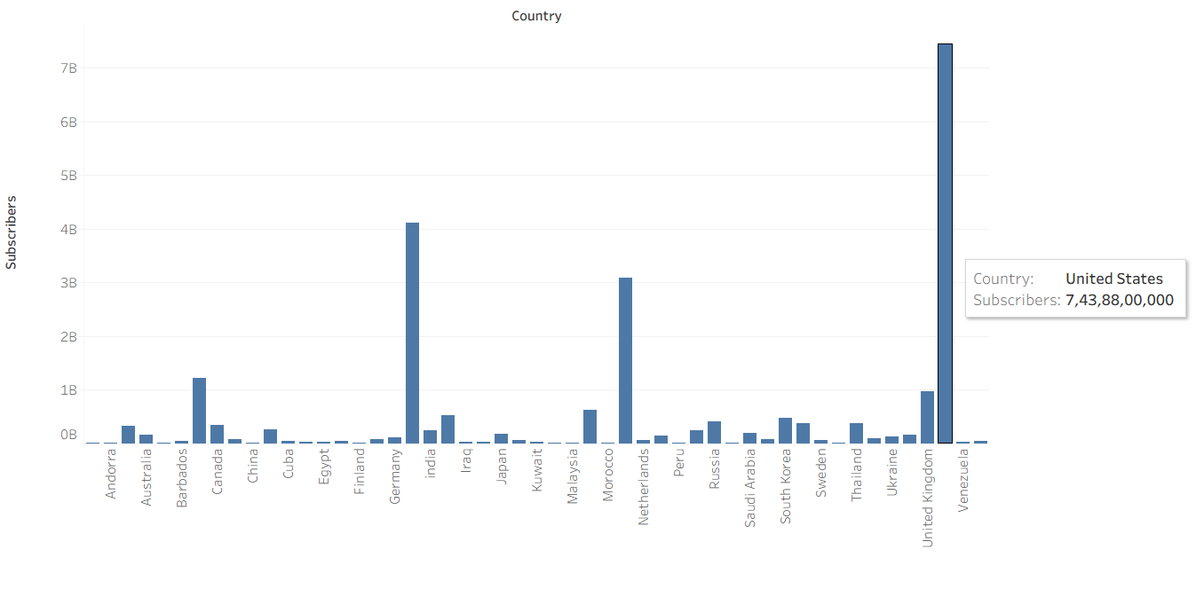
THE COUNTRY WITH HIGHEST SUBSCRIBERS IS UNITED STATES AS IT IS SEEN IN THE CHART BELOW

Slide 3
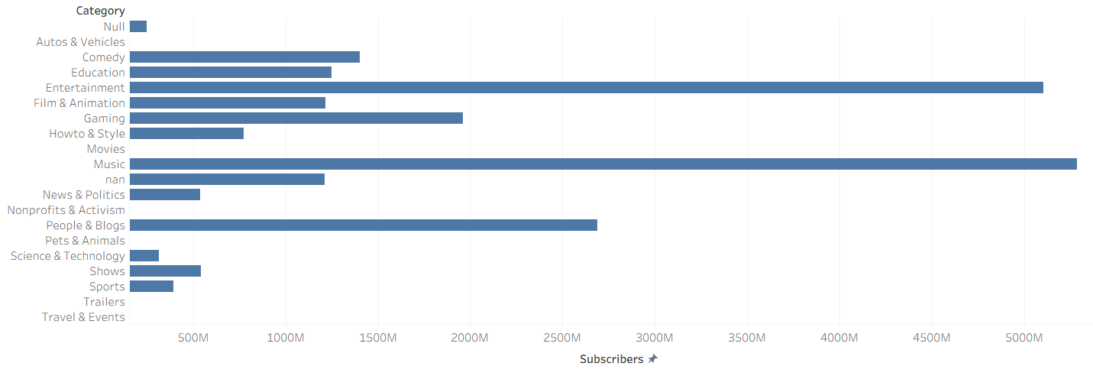
MUSIC IS THE CATEGORY WHICH ATTRACTS MOST OF THE SUBSCRIBERS

Slide 4
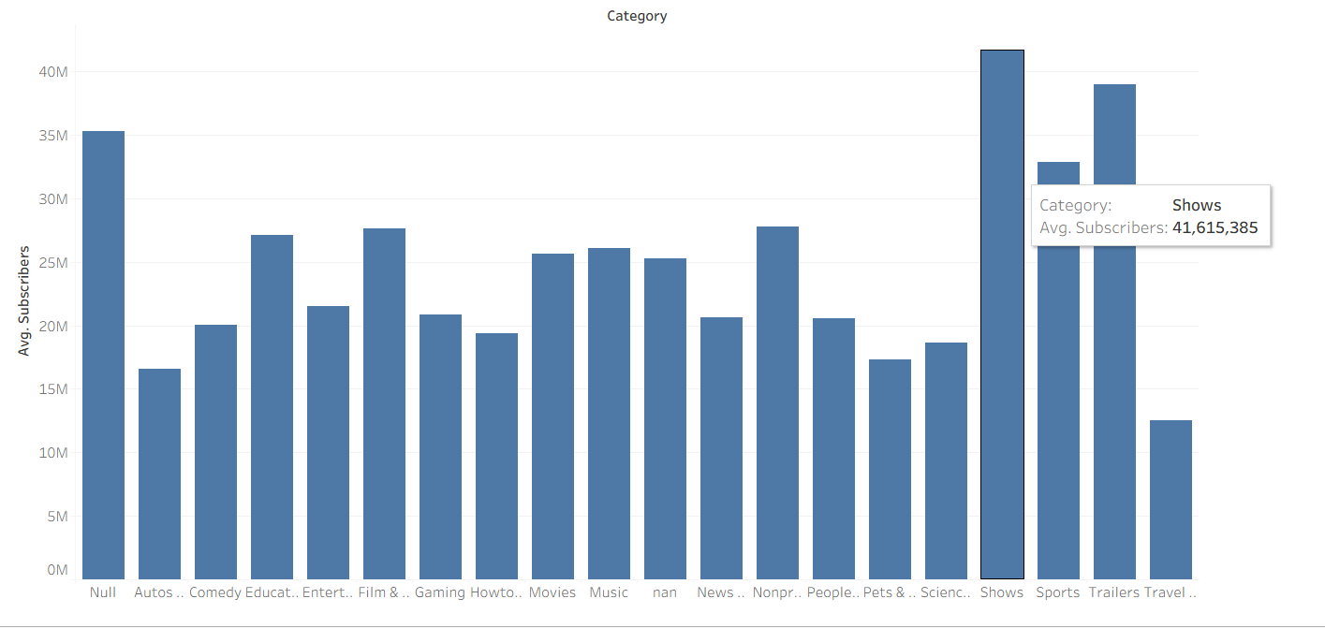
WHEREAS SHOWS IS THE CATEGORY WITH AVERAGE SUBSCRIBERS

Slide 5
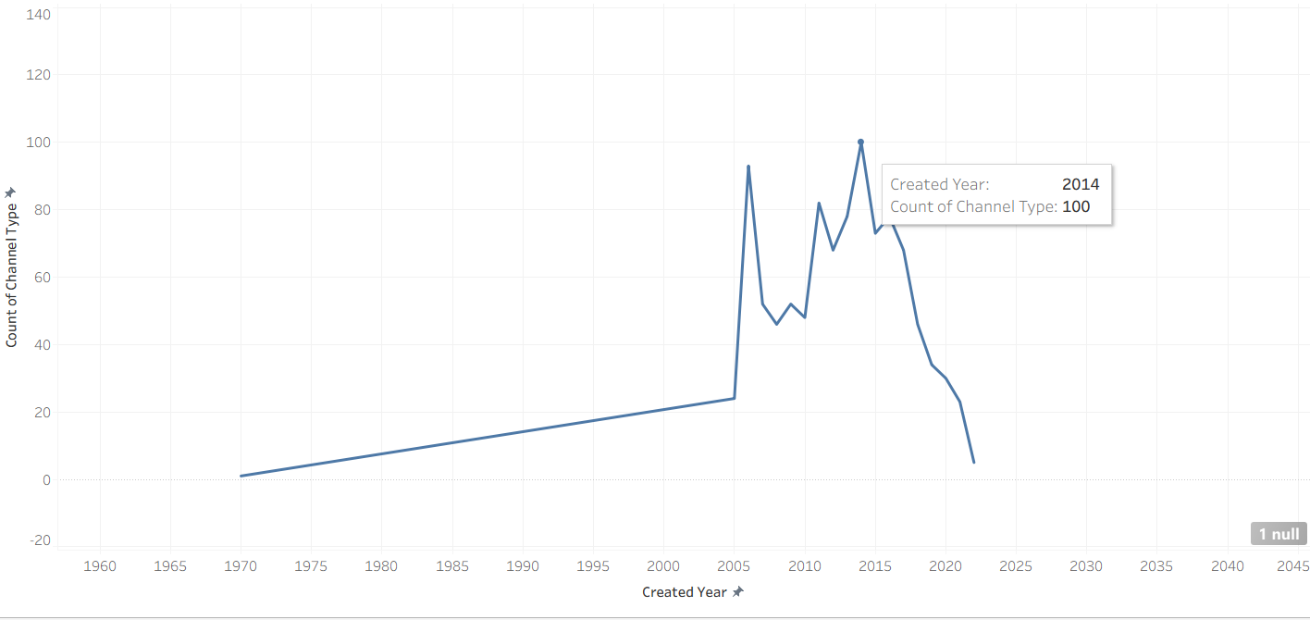
Trend of channel creation over time
Most channels were created in year 2014

Slide 6
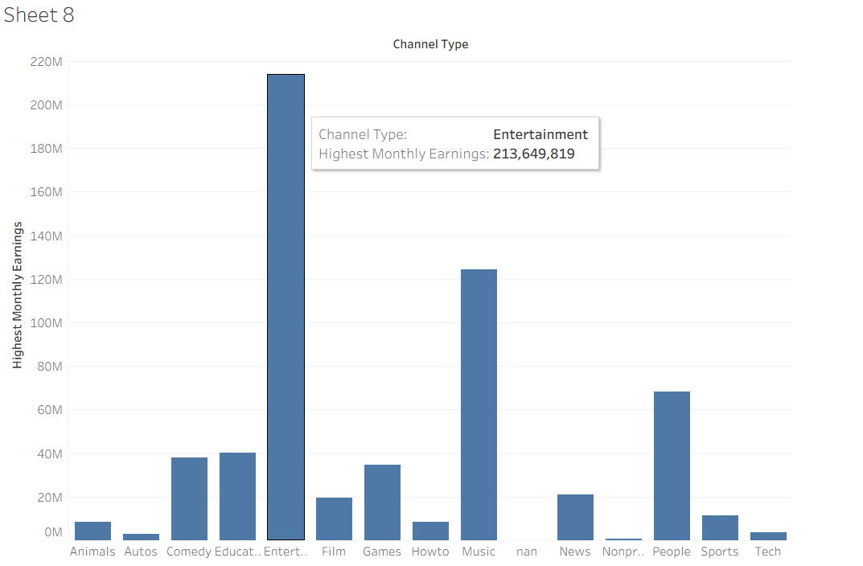
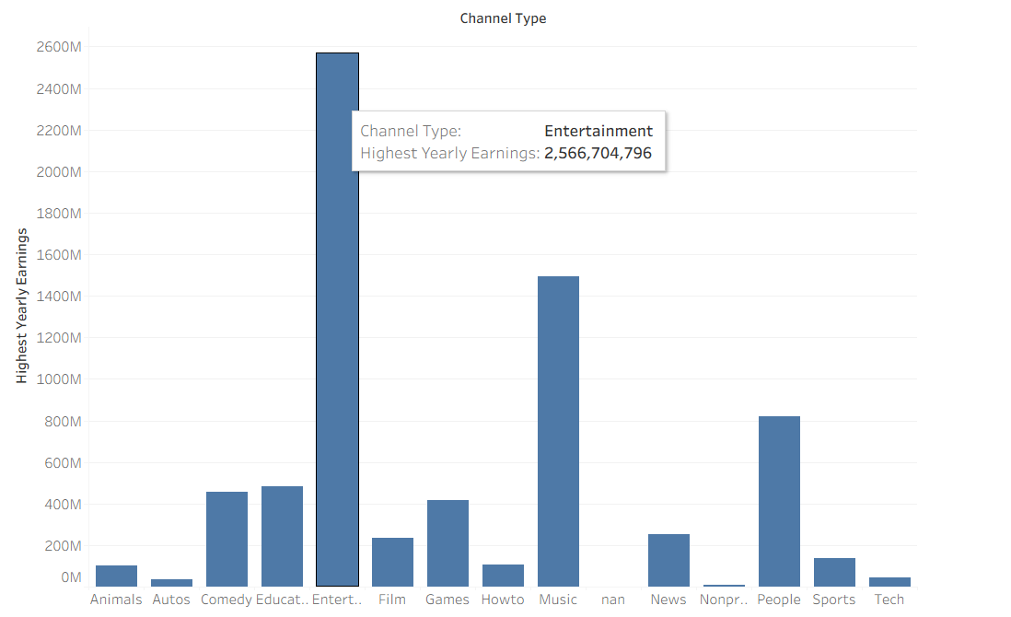
ENTERTAINMENT IS A CHANNEL TYPE WITH HIGHEST MONTHLY AND YEARLY EARNINGS

Slide 7
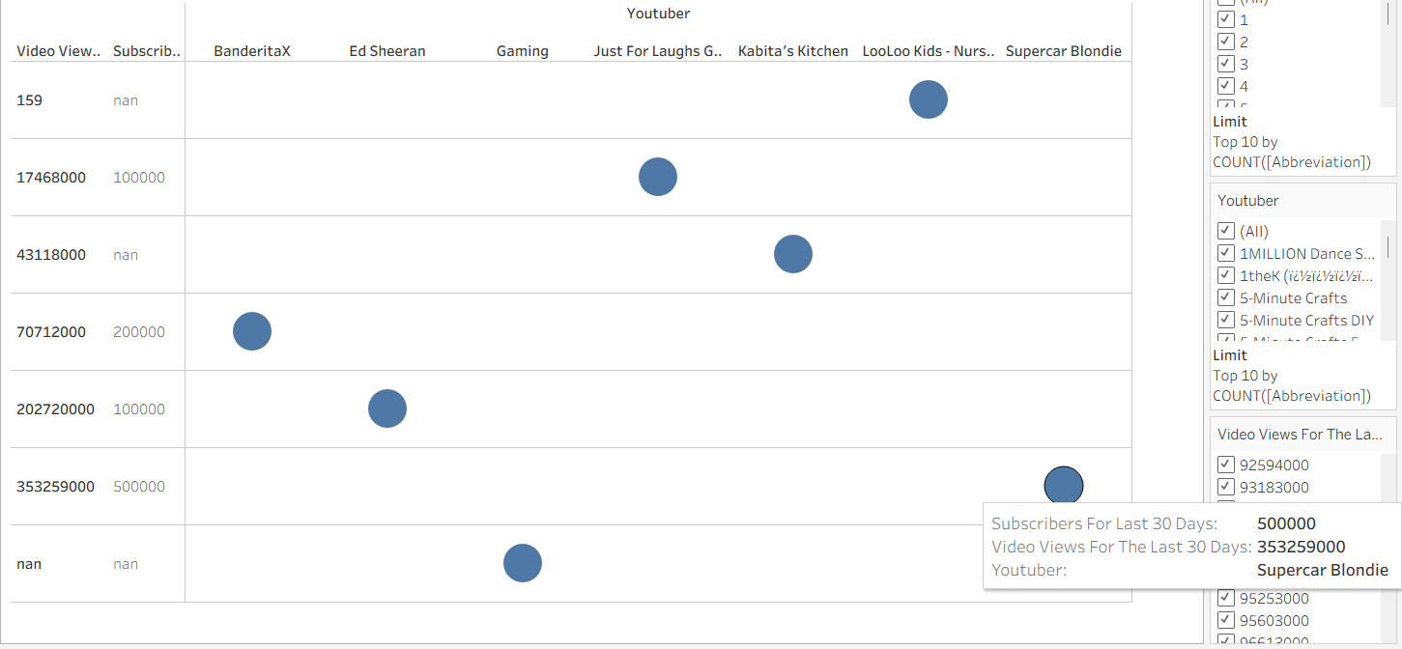
SUPERCAR BLONDIE HAS THE MAJOR BOOST IN THE SUBSCRIBERS
AND THE VIDEO VIEWS IN THE LAST 30 DAYS OUT OF TOP 10 YOUTUBERS

Slide 8
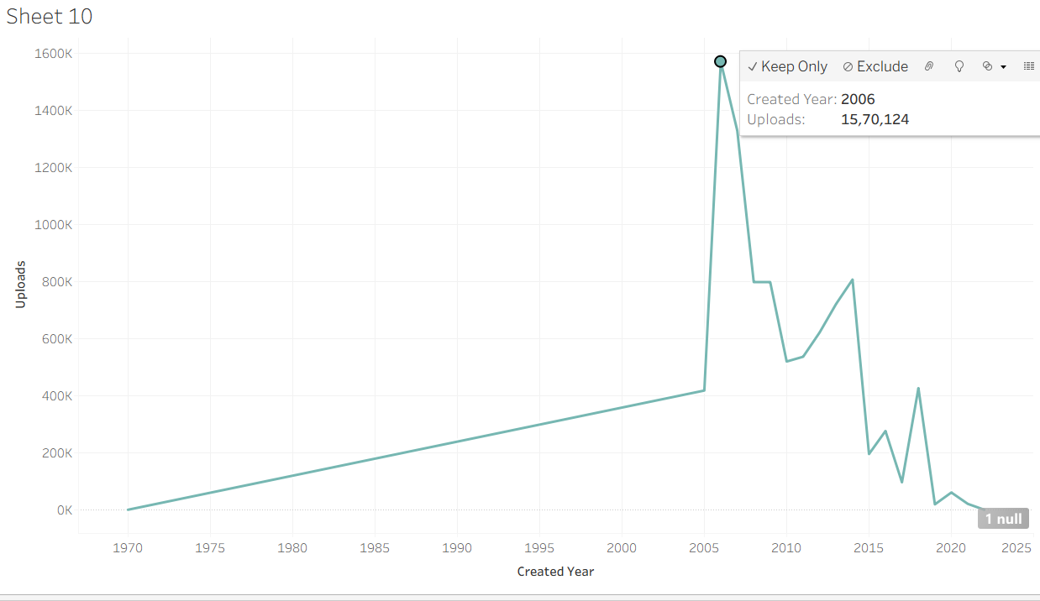
Trend Analysis

Slide 9
NOTE : THESE ARE THE MAJOR ANALYSIS TO DO FROM THE YOU TUBE ANALYSIS CSV DATASET
TABLEAU IS USED TO CREATE THESE CHARTS TO VISUALIZE AND
LOOK AT THE KEY INSIGHTS FROM THE DATASET

